Slide 1

Our First Climate Action Plan
Working Group Kickoff Meeting
Monday,
October 17, 2022
Notes:
Welcome to the Needham Climate Action Planning Committee Working Group Kickoff meeting! My name is Stephen Frail, and I am Chair of the Climate Action Planning Committee.
If you haven’t already, please seat yourself at the table with the name of the working group that you’ve joined. There are packets that are specific to each working group, which is another reason to sit at the correct table.
-- We are thrilled that you have all chosen to join us in this important effort --- developing the Town of Needham’s first climate action plan
-- There are a lot of familiar faces in the room, but also a lot of new ones. We’ll have some time to get to know each other later, but first I’d like to go over some housekeeping items.
Help yourself to refreshments at any time. This is a tough hour to meet, and while climate action plans can be a very exciting topic, it can seldom compete with a grumbling belly.
Restrooms are located just outside the back left door of the hall. There is also a water fountain there. We won’t have any planned breaks, as we are here together for just 90 minutes and have a fair amount of stuff to get through.
If at any point in time you have a question, please feel free to interrupt. I will be doing a fair amount of talking to you but I always appreciate the opportunity to hear other voices. I’m sure you all do, too.
I would also be remiss if I didn’t thank the Town staff that set up this hall for us, brought in refreshments, and helped pull together all the material you have before you.
I would also like to thank the Select Board for voting to make the creation of a Climate Action Plan a priority in 2021.Without that vote, this meeting would not be happening now.

Slide 2
Agenda
5:30 Welcome and CAP Overview
6:00 Working Group Process Overview
6:30 Working Group Breakouts
6:50 Regroup and Final Words
7:00 Adjournment
Notes:
We will start today with an overview of the Climate Action Planning Committee – why we are here, our progress to date, our timeline and process, and how the Working Groups fit in.
We will then take some time to discuss the Working Groups you have all agreed to join – objectives, guidelines, process, and what the expected output will look like.
We will then have about 20 minutes for the working groups to meet in small groups. This is a great time to get to know each other a bit and ask more questions. Each working group has a chair that is also an appointed member of the Climate Action Planning Committee. Tonight we will ask each working group to elect a co-chair to ensure that meetings can be held in accordance with open meeting laws even if the chair is unable to attend in person.

Slide 3
Welcome

Slide 4
No one is an expert
Notes:
Before we go any further, I want to state the obvious. Most of us have never drafted a Climate Action Plan before. This is new for all of us, and we may stumble, get confused, or feel unsure of our recommendations.
That’s OK. As we’ll discuss later, there are lot of models and examples that we can use to get our job done.
The important thing is that we think about what actions Needham should take to reduce its GHG emissions, what impact those actions can have given Needham’s GHG emissions profile, and what the level of effort would be for Needham to take those actions.
This brings me to my next point…

Slide 5
You are all experts
Notes:
You are all experts. You have lived experience here in Needham that will help ensure that our finished work is truly Needham’s Climate Action Plan. Just in this room we have several members of Town boards and committees, Town Staff, architects and developers, energy engineers, low-income housing experts, solar installers, fleet managers, biking advocates, educators, students, representatives from several houses of worship, clean energy market experts, electric vehicle advocates, members of the League of Women Voters, Mothers Out Front, Green Needham, and Equal Justice Needham. We collectively represent a cross-section of Needham, both the public and private sectors. Having all of these voices in the room, we hope, will ensure that balance the needs of the various stakeholder communities in Needham as we work to bring our GHG emissions down over the coming years, so both the costs and benefits of our decarbonization efforts are shared equitably.

Slide 6
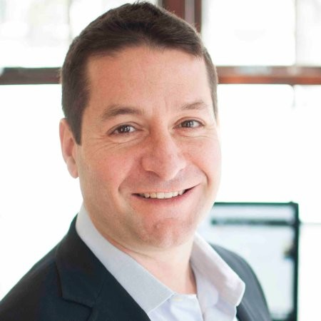
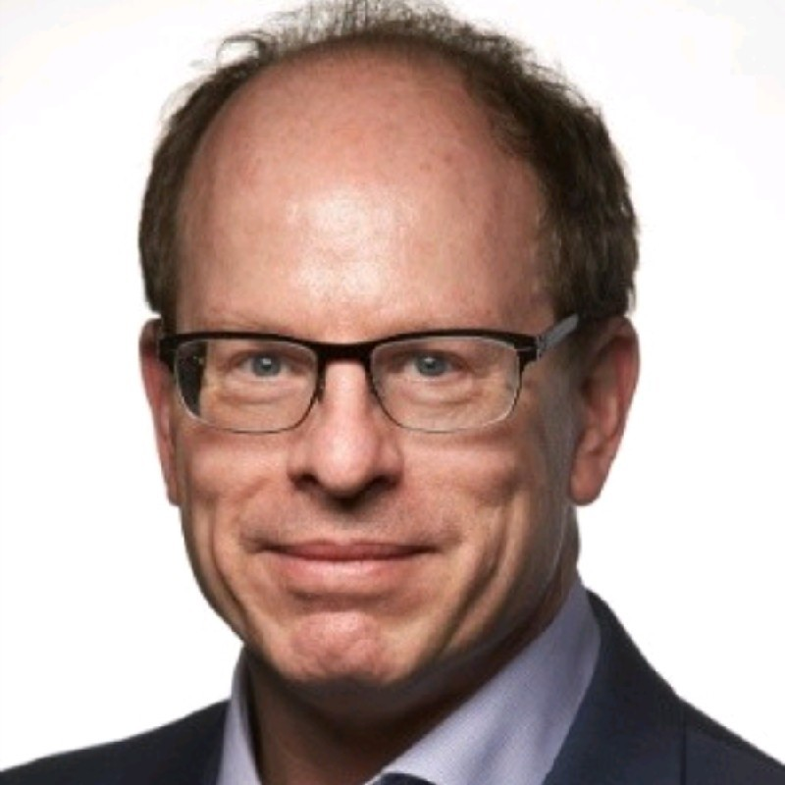
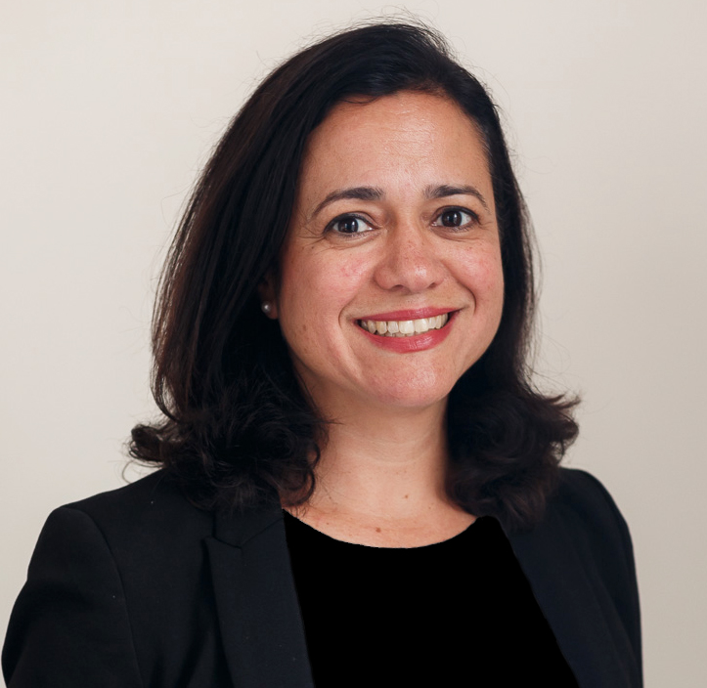
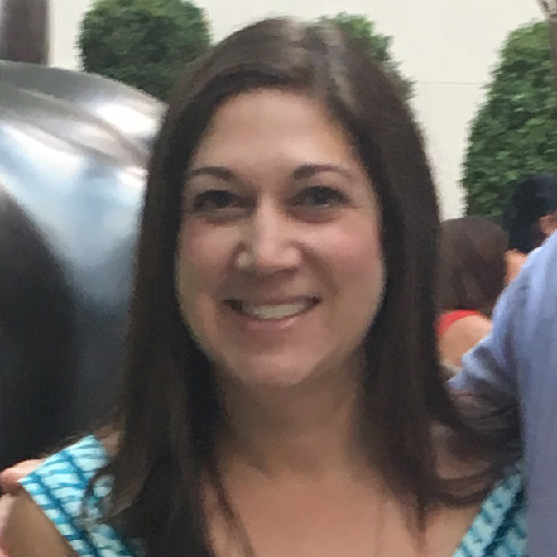
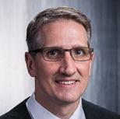

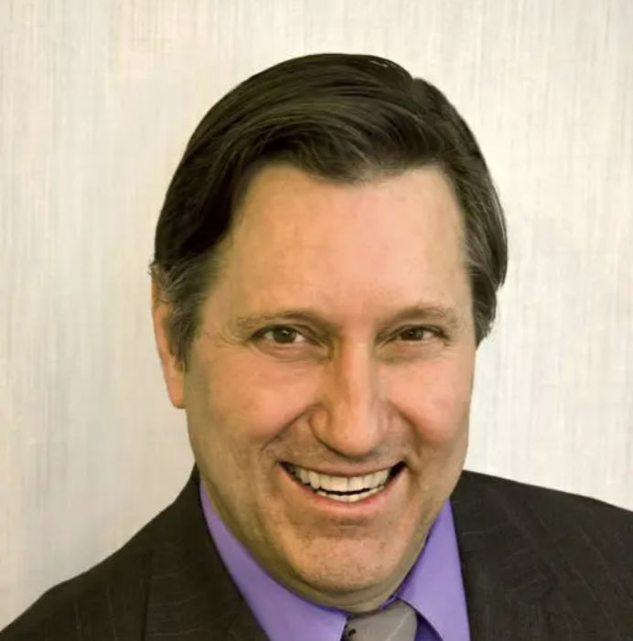
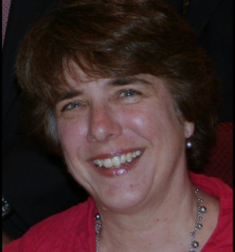
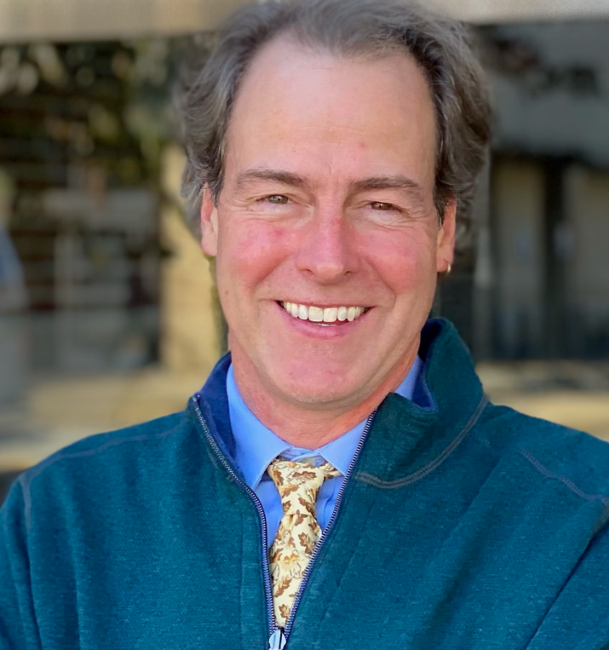
Climate action planning committee
Stephen Frail, Chair
Nick Hill, Vice Chair
Natasha Espada
Rachel Bright
Joe Higgins
Paul Delarippa, MD
Artie Crocker
Marianne Cooley
Select Board
Kevin Keane,
Select Board
Notes:
This is just a quick slide to introduce the appointed members of the Climate Action Plan. Can Nick, Natasha, Rachel, Joe, Paul and Artie all stand up?
And, our Select Board sponsors are Marianne Cooley, and Kevin Keane. Can you please stand up?

Slide 7
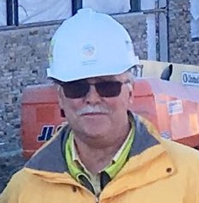
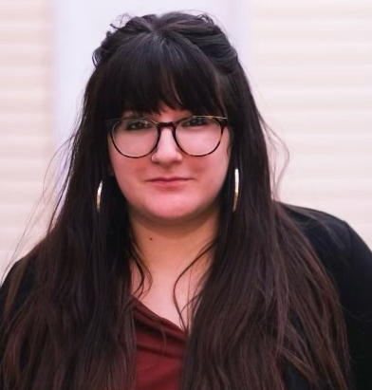
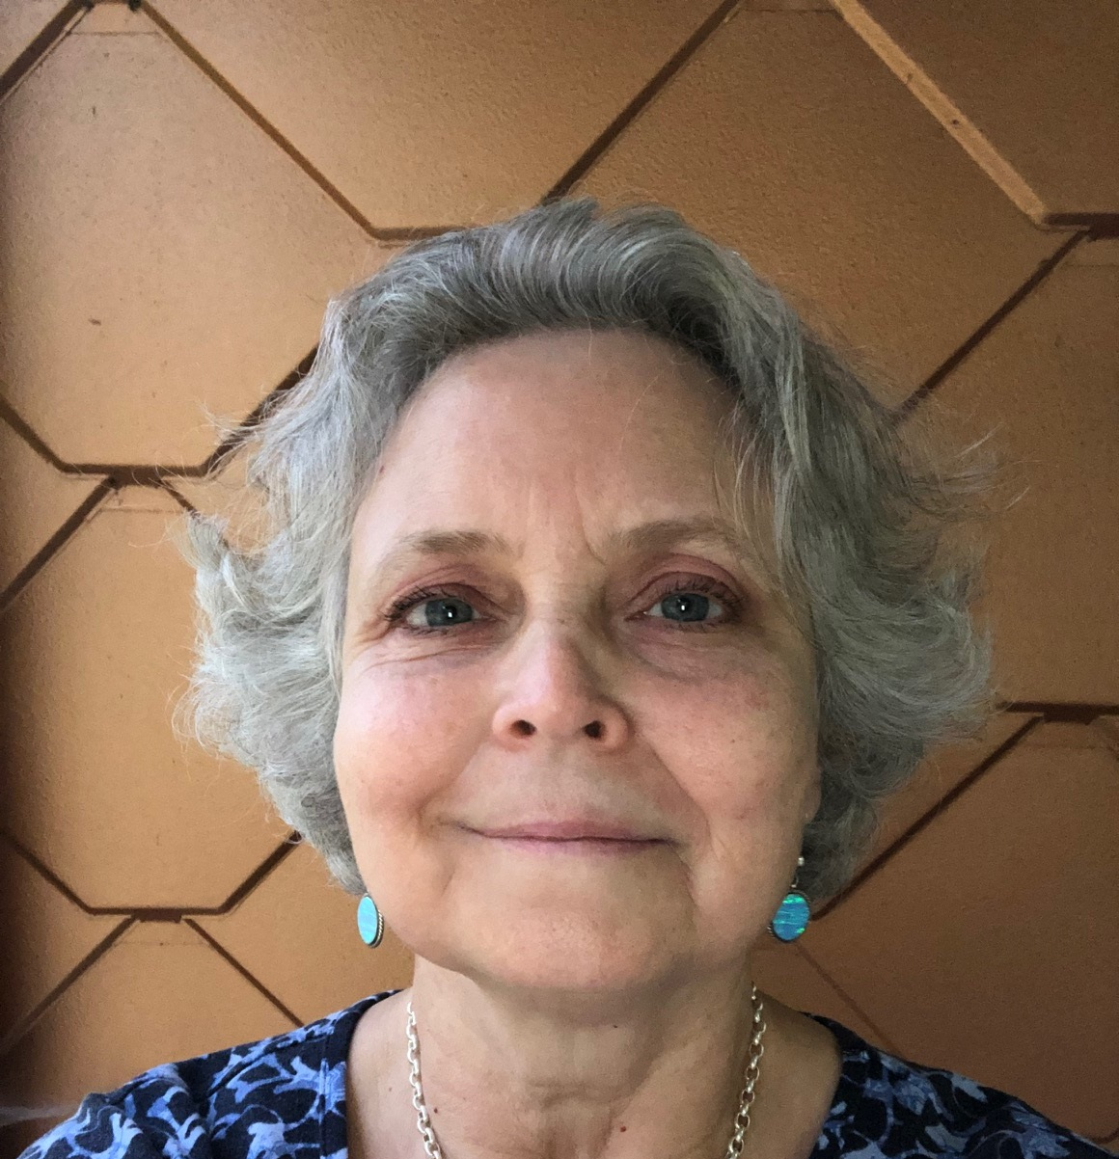
Needham Town Staff
Hank Haff,
Director of
Design and
Construction
Cecilia Simchak,
Director of Finance/Administration for Public Services
Kathryn Copley,
Administrative Specialist,
Building Design and
Construction Department
Notes:
There are also three members of Kate Fitzpatrick’s organization who are embedded in the CAPC. Hank Haff, Cecilia, and Kathryn, can you please stand up?

Slide 8
Why we are here
The Climate Action Plan Committee (CAPC) was established to guide the Town in developing a plan that meets or exceeds the State’s climate mitigation and resilience goals. The Committee will make recommendations to the Select Board on approval of a Climate Action Plan (CAP), and may be asked to continue to serve as an advisory committee to oversee the implementation of the CAP.
Notes:
Our goal as the Climate Action Planning Committee, with your help, is to develop a plan that gets Needham to Net Zero greenhouse gas emissions by 2050, while also hitting the State’s intermediate targets along the way. We will be making those recommendations to the Select Board, under whose charge we operate. The Select Board will set annual priorities through its standard processes, slotting our recommendations with the broader set of Town priorities.

Slide 9
CAPC Objectives
Definition of the climate action goals for each decade through 2050, with a focus on the next decade;
Strategic options and incentives that seek to overcome barriers to implementation of climate action goals;
Recommendations for any structural changes, resource, or staffing that would assist in implementation;
Actions to protect environmental justice communities from disproportionate effects of climate change;
Recommendations for implementing the plan across all sectors of the Town;
Measures that assist in tracking and reporting Town’s progress towards fulfilling climate action goals; and
Funding opportunities the Town should consider.
Notes:
Our scope includes not just the recommended climate actions, but recommendations for strategies for overcoming barriers to implementation, including staffing and resource allocation to assist the Town in implementation.
We’ve also been charged with considering the impact of climate change on environmental justice communities – i.e., those communities that disproportionately bear the negative impacts of climate change and environmental hazards (e.g., think about where coal burning power plants are often located) and which are often excluded from the receiving the benefits of decarbonization.
The final Climate Action Plan should include recommendations for implementing the plan across all sectors of Needham, include measure to track our progress towards meeting our goals, and identify funding opportunities that the Town and its constituents should consider as we move towards implementation of specific actions in the plan.

Slide 10
Timeline
Jul 2022
Draft CAP Outline
Draft Project Plan
Aug 2022
Agree to Project Plan with SB and Town Mgr
Develop Overview Presentations for Boards Staff
Finalize ask for Town Meeting
Sep 2022
Board Overview Presentations
Share Project Plan Town Dept Heads
Create Working Groups
Oct–Dec 2022
Working Groups Meet
Begin Public Outreach
Town Meeting
Jan 2023
Working Groups Submit Actions
Begin writing draft CAP
Report to Select Board
Spring 2023
Finalize CAP
Present to all Town Depts, Boards, and Town Meeting
Ramp up public outreach
Mar 2022
First CAPC meeting
Notes:
This timeline presents a high level overview of where the Climate Action Planning Committee has been and where it’s going.
We’re in October, and we are on schedule, with our first meeting of the Working Groups. Later this month Town Meeting will also vote on the first two asks of this committee.
Our collective goal is to have a draft of proposed actions from working groups by January 2023.
Those proposed actions will feed into the drafting of the Climate Action Plan we are looking to present back to the Select Board in 2023.

Slide 11
Progress on sustainability in needham
2014 – First Solarize Needham yields 99 new solar PV installations on homes
2016 – 12-acre, 3,592 kW solar array installed at RTS, generating $700k in revenue for Town, while producing 25% of the Town’s purchased electricity.
2019 – Solarize Needham Plus runs, generating 52 new solar PV installations on homes and converting 7 homes to efficient air-source heat pumps
2020 – Sunita L. Williams Elementary School opens with a roof-mounted 155 kW solar array. Earns LEED Silver rating
2020 – Needham adopts Stretch Energy Code and becomes a Green Community, which allows for state grant funding and commits us to reducing energy usage
2021 – Mitchell & Newman Elementary Schools, Pollard Middle School undergo lighting upgrades projected to save 142,056 kWh annually
2021 – Streetlight project in downtown completed, projected to save 21,637 kWh annually
2022 –Climate Action Plan Committee begins meeting work on Needham’s Climate Action Plan, with climate-related goals for 2030, 2040, and 2050
Other highlights:
The Public Services Administration Building is heated and cooled using geothermal energy.
Over 650 Needham homes now have solar PV panels installed on roofs
Ten (10) electric vehicle charging stations now installed at Sunita Williams, Rosemary Recreation Center, Chestnut Street parking lot, 470 Dedham Ave., and four (4) more will be installed at PSAB this summer
Needham has worked to install anti-idling technology in its Town vehicles,
Total energy consumption of the Town fell 9.4% from 2018 to 2021, despite increased building ventilation due to COVID-19.
  Energy use in all categories (except buildings) – open space, street and traffic lights, vehicles, and water and sewer – decreased from 2018 to 2021.
  The largest change was observed in the street and traffic lights category; energy consumption fell 60.6% from 2018 to 2021.
Notes:
The Town already has made substantial progress on green initiative prior to the formation of the Climate Action Planning Committee, and I’d like to spotlight a few.
In 2016, the Town had a 12 acre, 3.7 megawatt solar array at the Recycling and Transfer Station. The array produces $700K in revenue for the town while producing ¼ of the Town’s municipal electricity needs.
In 2020, the Sunita Williams Elementary School opened with a 155 kW solar array.
In 2020, Town Meeting adopted the state’s Stretch Energy Code and became a Green Community, which gave the Town access to a new source of grant funding for our conservation efforts.
Many may be surprised to hear that Public Services Administration Building is heated and cooled using geothermal energy.
And due to various conservation efforts, the Town’s energy consumption fell by over 9% from 2018 to 2021, despite additional building ventilation required because of the pandemic.

Slide 12
Progress on Climate Change in Massachusetts Law
Year | Massachusetts Bills Signed into Law
2008 | Global Warming Solutions Act One of first states to set GHG reduction goals Required state to begin report on GHG emissions, and set a 1990 baseline
2008 | Green Communities Act Established competitive grant program for municipalities that meet certain requirements Created Stretch Energy Code
2021 | An Act Creating a Next-Generation Roadmap for Massachusetts Climate Policy Sets Net Zero targets for 20 Requires DOER to develop a Net Zero building code Increases amount of clean energy used in electricity generation Creates pilot program to deploy geothermal heat pump micro-districts Provides broader access to solar through low-income services program trust Defines environmental justice community in state statute and creates job program
2022 | An Act Driving Clean Energy and Offshore Wind Major expansion of offshore wind Required electricity grid modernization to minimize impact on ratepayers Supports research into grid battery storage Funds EV charging infrastructure and requires all new cars sold after 2035 be zero emissions
Notes:
And, the state of Massachusetts is a leader on climate action. I won’t go through all the details on the legislation, but I do want to thank Representative Denise Garlick and Senator Becca Rausch for their support for legislation signed into law in 2021 and 2022 that has given those of us concerned about climate change a lot of hope. There is a lot of weight now being put behind decarbonization at the state level.
Our goal is to help the Town identify those funding sources and other forms of assistance that can help offset the cost of decarbonization for the Town.

Slide 13
Progress on Climate Change in Federal law
Year | Federal Bills Signed into Law
2022 | Inflation Reduction Act Sets 40% reduction target in GHG emissions by 2030 Funds home energy efficiency and electrification retrofit rebates for low-income consumers Creates new tax credits for heat pumps, rooftop solar, electric HVAC and water heaters New tax credits for Electric Vehicles made principally in the US Tax credits to manufacturers who build solar, wind, batteries, and raw minerals in US Investment tax credits for manufacturers that build clean manufacturing facilities Accelerates manufacturing of heat pumps to help wean US off imported fossil fuels Provides grants to US auto companies to retool plants to manufacture EVs Tax credits for clean electricity generation and storage Tax credits for clean fuels and commercial vehicles Grants and tax credits to reduce emissions from industrial manufacturing processes Funds electrification of federal vehicles such as US Postal Service vehicles Funding reduction of methane leaks from the production and distribution of natural gas Invests in Environmental Justice communities Invests in more sustainable agricultural practices and land management Funds tree and forest conservation
Notes:
And, many of you are aware of the Inflation Reduction Act signed into law this year in DC. Again, I won’t go into all the details, because you can read up on the law on your own. The bottom line is that this was the most significant piece of climate legislation passed in the US in history, and again, it provides numerous grants and tax credits to consumers, businesses, and other organizations to offset the cost of decarbonization. I encourage all of you to spend some time learning about the IRA, as it is a great source of material for the recommended actions.

Slide 14
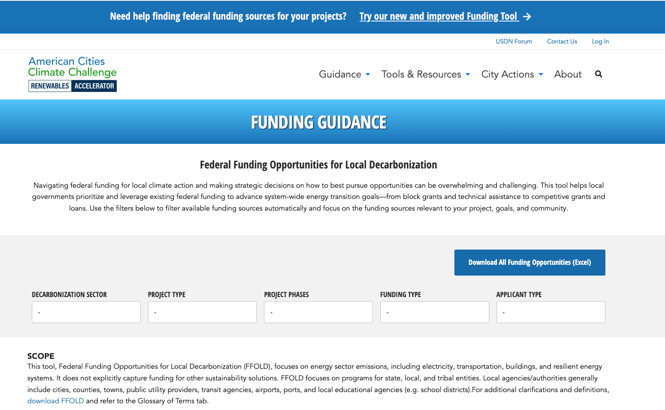
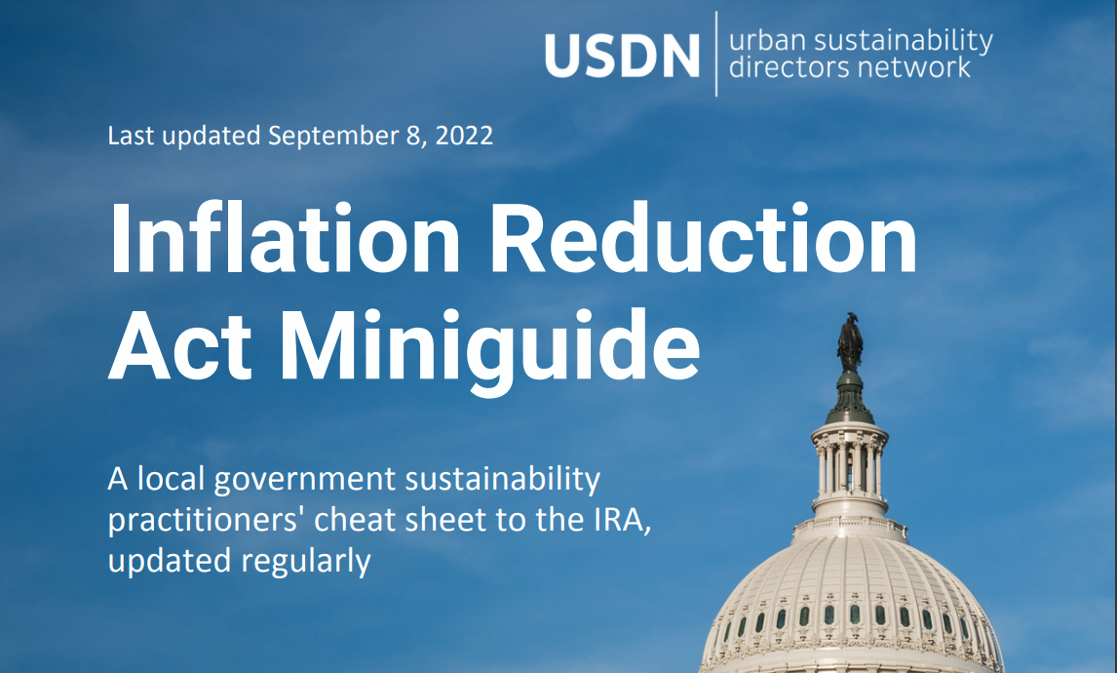
Resources on Funding
American Cities Climate Challenge Funding Guidance https://cityrenewables.org/ffold
Urban Sustainability Directors Network Inflation Reduction Act Miniguide https://www.usdn.org/uploads/cms/documents/ira_for_members.pdf
Notes:
There a number of great summaries of the IRA out there, but here are two that are great places to start if you’re not familiar with the climate provisions in those acts. We’ll make sure everyone has a copy of this deck after the meeting.

Slide 15
Reducing GHG Emissions will require a collective effort by Town residents, businesses, and other organizations
Town of Needham’s Share of GHG is only 2.4%
Needham’s Greenhouse Gas Emissions BY SECTOR
Notes:
Ok, let’s start getting into the details of the work before us.
To begin with, Green Needham conducted a greenhouse gas inventory to help us understand our baseline. The pie chart you see before you is our GHG emissions by sector.
Two things to note:
1. Passenger vehicles, residential buildings, and commercial buildings all create about the same amount of greenhouse gas emissions, and collectively represent almost 90% of the Town’s emissions.
2. That small blue slice in the lower left, that’s the MUNICIPAL sources of greenhouse gas emissions. Just about 2.5% of our Town’s emissions are under the direct control of Town government.
You can see that reaching Net Zero is going to require a collective effort across all sectors of the Town.

Slide 16
The Basic Formula to Net Zero
Electrify everything
(heating, cooling, transportation)
Green the electricity grid
(solar, wind, geothermal, etc.)
Needham’s Greenhouse Gas Emissions BY source
Notes:
Here’s a slightly different view of our Town’s greenhouse gas emissions.
Note that fossil fuel heat (e.g., gas furnaces) accounts for 40% of our emissions, while transportation fuels make up almost 30%.
You can see in this picture that electricity represents almost a quarter of our greenhouse gas emissions.
That’s because much of our electricity comes from the burning of fossil fuels, such as natural gas or coal.
The basic formula for decarbonization is to electrify everything and green the electricity grid.
Decarbonizing heat and transportation will take time, as people hold onto their vehicles and furnaces for many years.
However, we can green the grid more quickly. For those of you who are paying attention to the town meeting warrant, you know there is an article to authorize the Town to pursue community electrical aggregation, a tool that allows the Town to negotiate the electricity supply on behalf of Town ratepayers to secure more favorable rates on greener electricity than supplied under the Eversource basic electricity service.

Slide 17
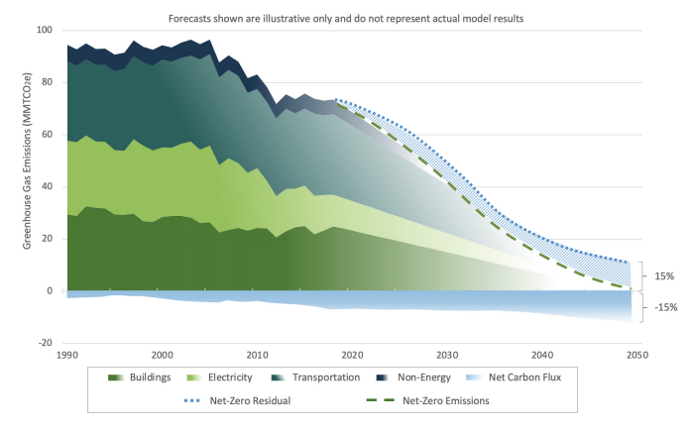
Net zero by 2050
Notes:
This is what the basic formula looks like if you implement it out over several decades. Decarbonizing electricity – the light green – can happen more quickly and steadily. Transportation – the ligher blue – takes longer to decarbonize, but will hit a tipping point in the 2030s as electric vehicles overtake internal combustion engines. Buildings, -- the dark green – takes the longest to decarbonize, as the lifecycle of buildings and their HVAC systems are longer.

Slide 18
Working group process overview
Notes:
Let’s shift gears now to discuss the Working Group Process.

Slide 19
Developing a Climate Action Plan
Working Groups
Identify Potential Actions
Town Staff and Boards
Estimate impact
Community
Regular updates
Highlight potential impacts
Gather feedback
Public hearings
Solicit feedback
Calls to action
Prioritize actions
Final Action Plan
Share with Boards, Staff, TMM
Begin implementing actions, with warrant articles submitted to TMM as required
Notes:
First, the Working Groups are part of a larger process that includes the appointed Climate Action Planning Committee, other Town Staff, Boards, and Committees, and the broader Needham community. This will be an iterative process, with opportunities to solicit feedback from various stakeholders across the Town that will inform the final plan.
Once the final plan is published, various actions will be taken up and deliberated on further. Many of those actions will require additional input as they’re considered for implementation, and some will require affirmative votes at Town Meeting.
The Climate Action Plan, in other words, is a set of informed recommendations that the Town will use to inform annual priorities. The Climate Action Plan is not a set of required actions. Why am I taking the time to underline this?
First, this Climate Action Plan does not supplant the decision-making processes in Town.
Second, it’s important to understand that we will need to do a good job of prioritizing actions and providing sufficient information about the impact and level of effort associated with implementing those actions that others in Town will be better able to evaluate how to fit those actions into the larger set of priorities that compete for the attention of Town staff, boards, committees, and Town Meeting.
That’s where you all come in. We have set up six working groups who will focus on specific areas so that they can identify the priority actions in that area and put some meat on the bones.

Slide 20
Needham Town Government
Executive
Legislative
Town Manager
Departments
Elected Boards
Appointed Boards
Town Meeting
Select Board
Planning Board
Park & Rec
School Committee
Finance Committee
Conservation Commission
Council of Economic Advisors
This is just a partial list
Notes:
For those who aren’t familiar with Needham Town Government, I am including this extremely simplified chart.
The Executive function includes both elected (such as the Select Board, Planning Board, Park and Rec, and School Committee) and appointed boards (such as Finance Committee, the Conservation Commission, the Council of Economic Advisors). This is only a partial list.
The Legislative body is Town Meeting, which typically meets twice per year – in the spring and fall.
The Town Manager, under the supervision of the Select Board and with funding approved by Town Meeting directs the work of all Town staff.
The key takeaway I’d like you to have from this is that proposed actions from this committee will likely have to also be reviewed and/or acted upon by several other boards or committees and may also require the approval of Town Meeting. That’s before they ever reach the Town Manager and the departments that may take action on them.
It will, in other words, take time for actions to be implemented, so we should be very strategic about the actions that we propose in our final plan.

Slide 21
Working groups
Zero Emissions Transportation | Net Zero Buildings
Clean Energy Supply | Climate Smart Zoning & Permitting
Natural Resources / Zero Waste | Governance
Paul Delarippa, MD
Joe Higgins
Nick Hill
Natasha Espada
Artie Crocker
Rachel Bright
Notes:
Here are the six working groups, along with the Climate Action Planning Committee member who will be chairing the working group.

Slide 22

Working group Example actions
Governance
Zero Emissions Transportation
Net Zero Buildings
Clean Energy Supply
Climate Smart Zoning & Permitting
NZE incentives in Zoning
Sustainability Coordinator
Public Building Sustainability Guidelines
GHG in budgeting
Public GHG dashboard
Public messaging of CAPC
Community Electricity Aggregation
Residential Solar
Renewable Portfolio Standards
Municipal Renewable sites
Community Geothermal
NZE municipal Buildings
Ban fossil fuels in new/ renovated buildings
Special permits with By Right for NZ equipment
40R Smart Growth Zoning
Opt into PACE
Voluntary BERDO
MassSave incentives for decarbonizing HVAC
Solar requirements for large buildings
Sustainable Transportation Plan
Electrify fleets
Promote EV adoption
Electrify landscaping equipment
Facilitate walking/cycling
Natural Resources /
Zero Waste
Tree Preservation
Impervious surfaces bylaws
Expand Wetlands
Expand composting
Food rescue
Fix Water Pumping Station
Notes:
I’m not going to spend time on this slide, but include here just to give you a sense of the kinds of actions that might be considered in each group. These example actions were drawn from other Town’s climate action plans.

Slide 23
Working groups guidance
Focus on
Don’t focus on
Actions that reduce Needham’s GHG emissions the most
Actions Needham can control
Priority actions we should take in the next 10 years
Actions that may be good for the environment, but don’t directly impact GHG emissions
Actions that require entities (e.g., Federal government or private sector) outside of Needham to do something new
Actions that can’t be taken in the next 10 years
Notes:
Some high-level guidance for the Working Groups.
First, the scope of this committee is on reducing greenhouse gas emissions. While I sure many of us are also concerned about other issues such as pesticide use, biodiversity loss, and plastic bag bans, please keep the focus on actions that are going to have a measurable impact on our Town’s greenhouse gas emissions.
And, we need to focus actions that we can reasonably control, not something entirely dependent upon outside entities. That’s not to say that we should think only inside Needham’s borders. There may be actions that require support from our state or federal representatives. The slow pace of the DPU’s review of community electricity aggregation plans seems like something our Town may want to ask our state representatives to work on, for example, as it has a direct bearing on our ability to pursue a CEA for the Town. The caveat here is to try to keep the focus on what we can reasonably control.
And finally, our focus should be on the next 10 years, since that’s when we need to make the changes with the biggest impact. We also don’t know what the future might hold, so focusing too much out into the future is too speculative.

Slide 24
Working groups guidance
Leverage MAPC toolkit & other Town’s CAPs for ideas
Focus on the 3 to 5 biggest “bang for the buck” actions for Needham
  Estimate both impact and level of effort for those actions
  Include equity considerations with all actions
Talk with other stakeholders
Be aware of overlap with other working groups
Capture other action ideas (but spend less time on them)
Notes:
As you all begin your work, another piece of advice we would like to stress is to not reinvent the wheel. There are dozens of cities and towns who have completed their Climate Action Plans, and they are all out on the web. Your working group chair can point you to samples that the CAPC has gathered.
There is also a fabulous set of tools that the Metropolitan Area Planning Council developed.
We are asking each Working Group to focus on 3 to 5 (no more than 5) priority actions – the ones that have the biggest impact for the effort. To the extent possible, we are asking the working group to estimate the impact and level of effort. And, consistent with our charge, we are also asking you to document equity considerations for each action.
As you go about your work, we encourage you to reach out to other stakeholders who may have information or perspective that could inform your work.
Though we have divided you into 6 groups, keep in mind that there are areas of overlap. Zoning and permitting, for example, has overlap with green buildings. Clean energy has overlap with transportation. Talk to each other to manage the potential overlap, both to make sure nothing falls through cracks and there’s limited duplication of efforts.
Finally, while we are asking you to focus on the priority options, you will no doubt have other actions that are important. Please don’t discard those ideas. Capture them, but don’t spend as much time fleshing them out. Those may be the types of actions that could be implemented opportunistically, or they may become priority actions at a later date, so we don’t want to lose sight of them.

Slide 25
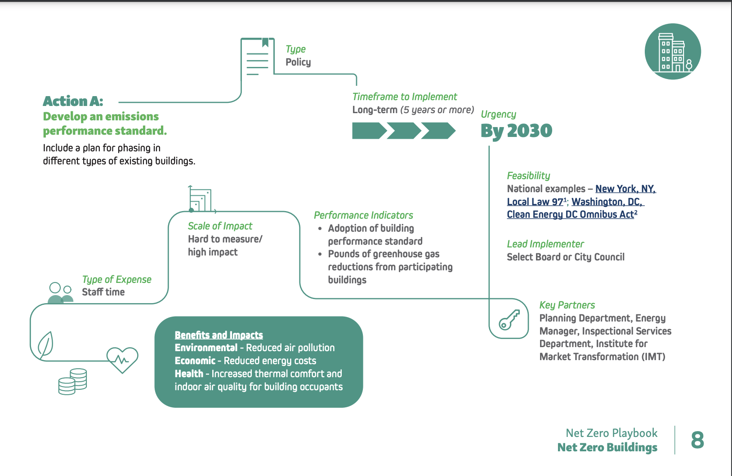

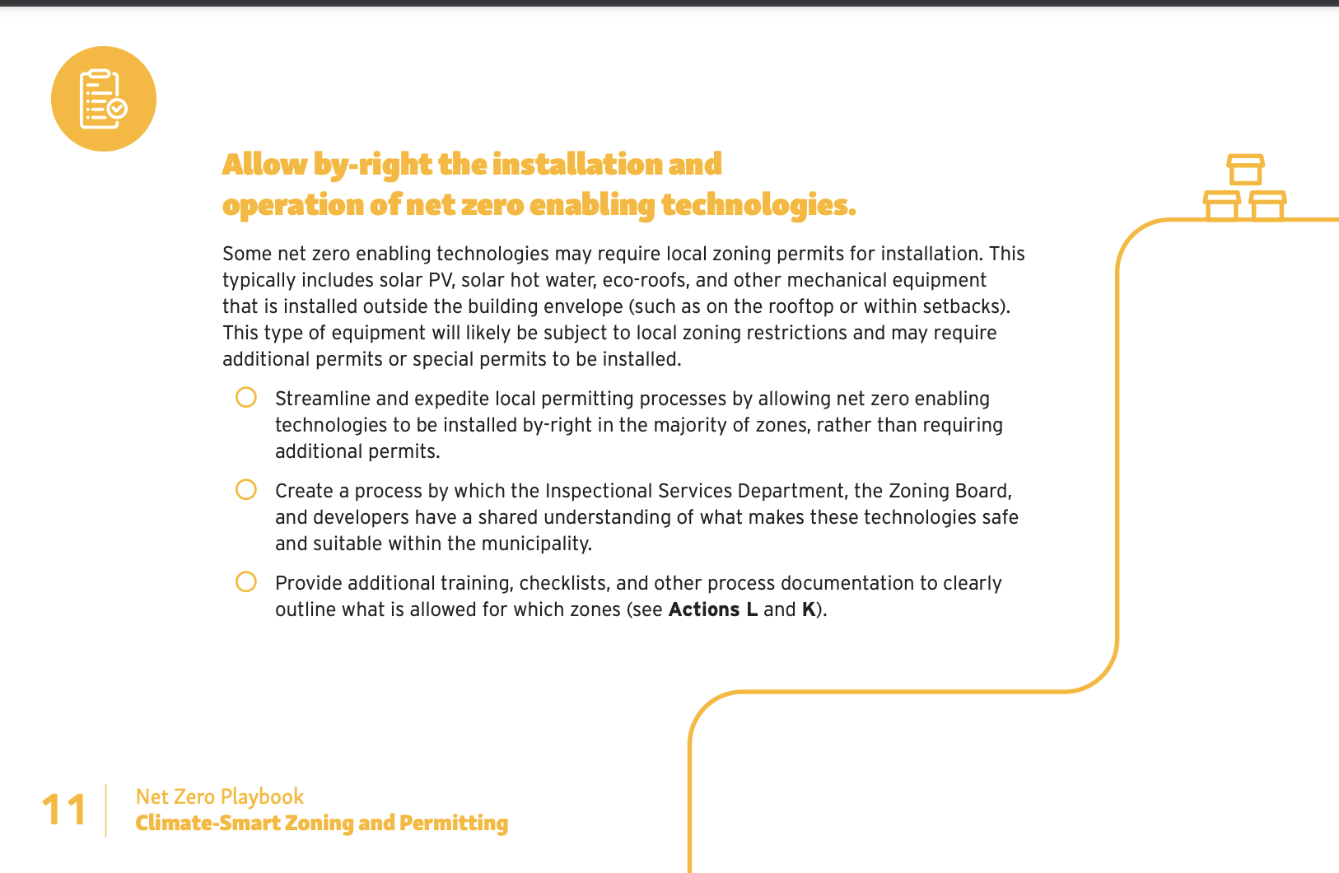
MAPC Municipal net zero toolkit
Notes:
I mentioned the MPAC Municipal Net Zero Toolkit. We’ve inserted the relevant chapter for each working group into the packets you have in front of you.

Slide 26
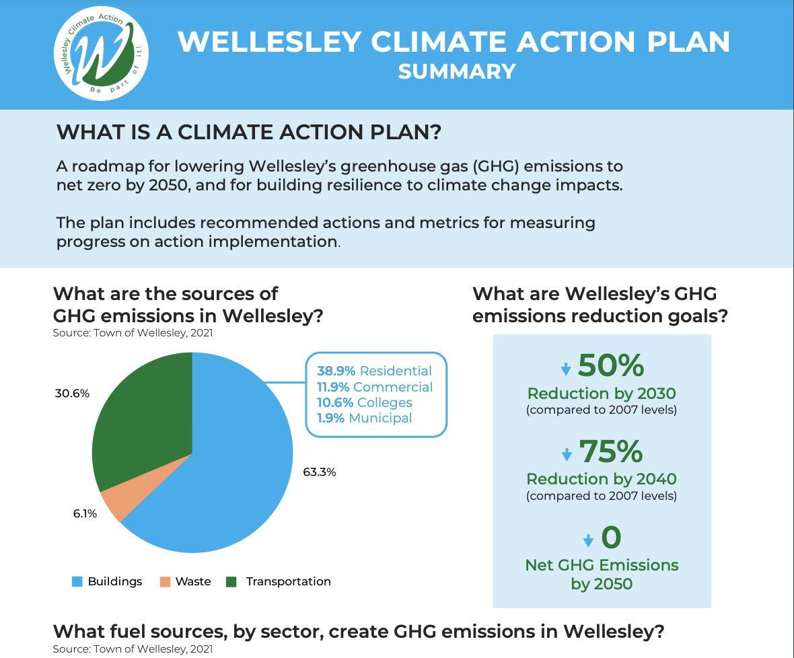
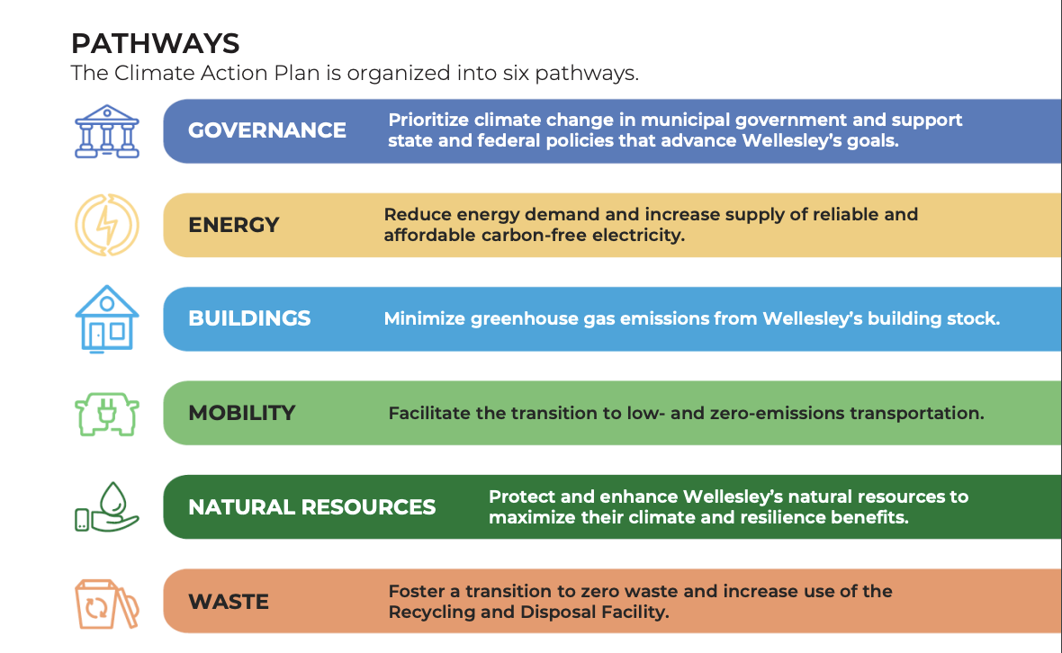
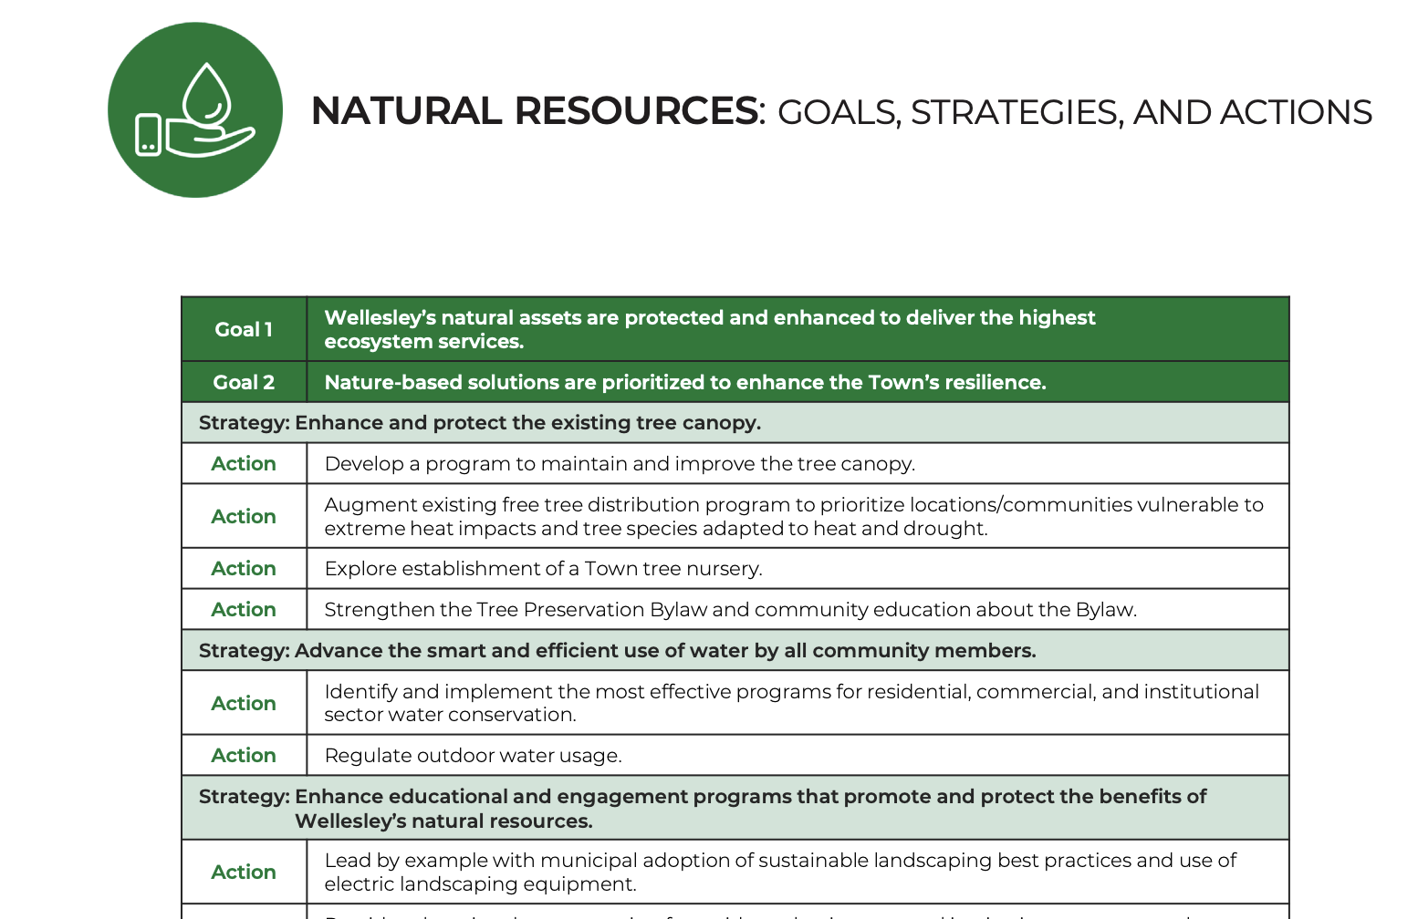
Existing climate action plans
Notes:
If you have never read a Climate Action Plan, please spend some time this week looking at the published climate action plans of other cities and towns. I would definitely recommend Wellesley’s CAP, as it is accessible and well done. The CAPC leaned heavily on peer town’s such as Wellesley as we organized ourselves and planned the work.

Slide 27
SAMPLE FRAMEWORK - For illustration purposes only
High
Low
High
Notes:
As you prioritize your actions, you may find this framework handy. The Climate Action Plan has adapted from other sources to help us think about how to compare two actions against each other. The actual values above are for illustration purposes only – don’t take them as gospel. They represent seat of the pants rankings our non-expert group assigned without digging in deeper.
The benefit of the framework is to help us group actions. The upper left represent actions that are comparatively low effort – high impact. These are the actions we should likely prioritize first. Pursuing a CEA is one action that this committee has already prioritized.
Top right are the high impact – high effort actions that require a little more forethought to implement. Moving our Town buildings to net zero cannot be done overnight, but would have a measurable impact on emissions.
Bottom left are the low effort but low impact actions. We should capture them and they be ones we can implement opportunistically. They may also be important symbolically, or be important for other reasons. For example, in the overall scheme, electrifying school buses has a small impact on our GHG emissions, but they show the Town as leading by example and also demonstrate to others that electrified transportation is possible. They also may improve public health by eliminating diesel particulates, which can exacerbate asthma and other conditions in children.

Slide 28
Working group output
Notes:
Working Group Chairs will capture the output of your discussions in a template that will identify your prioritized actions.
As you’ll see in the template, we’re not just looking for the actions themselves, but what the key benefits are of the actions, the time frame in which the action should take place, the scale of impact, the type and scale of cost, performance indicators, feasibility and equity considerations. Some of this information you may be able to discern from the MAPC toolkit or other climate action plans. Some you may be able to draw upon your own knowledge. And some may require conversations with town staff or boards or other experts outside of your working group. All we ask is that you do your best to complete the template for your prioritized actions. Keep in mind that the MAPC toolkit is a template – their consideration of implementation effort or timeframe may or may not apply to our situation.
You will also likely generate more ideas beyond a top 3 to 5. Don’t discard those ideas. Please capture them as “Other Actions” that can be considered at a later date, or which may be able to implemented opportunistically.

Slide 29
Governance Working Group
How should the Town integrate sustainability into its policies and executive operations?
How do we engage the community in a Town-wide effort to implement the CAP?
Who (public or private) can the Town partner with to achieve our CAP goal?
What state and federal climate-friendly rules and policies might we support to further our CAP goals?
Leadership, Resources, Accountability
Notes:
I want to take a moment to discuss the Governance working group, since it is a bit different from the others in that its actions aren’t so much about specific GHG emissions reductions as they are about process. This group will be more focused on how the Town can integrate sustainability into its policies and operations – so it can lead by example, help bring resources to the broader community, and provide accountability to our Climate Action Planning.
Wellesley has a nice set of actions in this area.

Slide 30
Open meeting laws ensure transparency in the deliberations on which public policy is based
Working Group chairs are responsible for working through the CAPC chair to post meetings, minutes, reserving rooms in Town buildings
All meetings must be posted on Town website at least 48 hour prior to the meeting
Elect a co-chair who can sit in place of the chair if they are unable to attend a meeting
Assign someone to keep minutes at each meeting
Avoid creating a quorum for any Town board or committee in your working group
Visit www.mass.gov/ago/openmeeting for more information
Notes:
Town counsel has determined that the working group meetings are subject to open meeting laws. Working chairs are responsible for ensuring their groups adhere to the open meeting laws. I’ve asked the chairs to work through me with the Town to post meetings, minutes, and reserve rooms in Town buildings that are accessible to the public.
Note, these working groups, because they are advisory (i.e., we do not set policy or make any decisions in an official capacity), are not bound by conflict of interest laws.
When meeting, please be careful not to create a quorum, which means >50% of the body is in your meeting. For example, tonight we have two select board members – if just one more select board member were to be here tonight – say to lend moral support to her husband – we’d have a select board quorum, which, while it might be great for me, it would cause a problem for the select board.

Slide 31

Working group breakouts
Introductions and exchange contact information
Elect a co-chair
Set meeting dates for November – January
WG Chairs to provide all meeting dates back to CAPC chair after this meeting
Notes:
We will now go to break out groups. You will have until 10 of 7 to meet. While you are together, take a little bit of time to get to know each other and exchange contact information, but just as important, please
Elect a co-chair
Set meeting dates and times for your working group in November through January
I will ask that Working Group chairs to provide that information back to me after this meeting so that I can work with the town to reserve space, post meeting announcements, and the like.

Slide 32
Final words
Your work will provide the raw material for the final CAP
An outside consultant will help us integrate and finalize the plan
We will meet again in 2023 to review the plan and solicit feedback
Your leadership on climate actions is always welcome

Slide 33
Thank you

