Slide 1

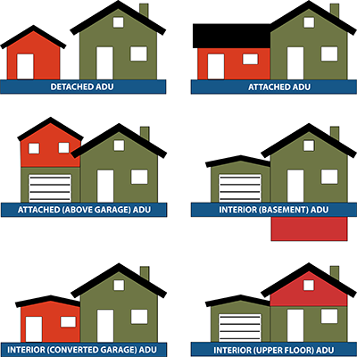
Planning Board
Public Hearing
3/7/23
Accessory Dwelling Units
Photo credit: APA 2023

Slide 2
Planning Board
Public Hearing
3/7/23
Accessory Dwelling Units
 | Current Condition | Proposed Condition
Size | Up to 850 sf | Up to 900 sf
Attached | By special permit | By right
Detached | No | By special permit
Access | Limited family and caregivers | Expanded family and caregivers
Tenancy | No | Yes, < 12 mo

Slide 3
Planning Board
Public Hearing
3/7/23

Slide 4
Planning Board
Public Hearing
3/7/23

Slide 5
Planning Board
Public Hearing
3/7/23

Slide 6
Planning Board
Public Hearing
3/7/23

Slide 7
Planning Board
Public Hearing
3/7/23

Slide 8
Planning Board
Public Hearing
3/7/23

