Slide 1

The Town of Needham 2022 Community Survey

Slide 2
ABOUT the NCS
The National Community Survey™ (The NCS™) report is about the “livability” of Needham. A livable community is a place that is not simply habitable, but that is desirable. It is not only where people do live, but where they want to live. The survey was developed by the experts from National Research Center at Polco

Slide 3
Study method
The report provides the opinions of a representative sample of 630 residents of the Town of Needham collected from April 11th, 2022, to May 30th, 2022.
The margin of error is 4% for all respondents.
Response rate for the 2022 survey was 23%. Survey results were weighted so that the demographic profile of respondents was representative of the demographic profile of adults in Needham.
47th time survey has been conducted – last time in 2018, and before that in 2016, 2014, 2012, 2010, and the first time in 2008.
Benchmark to 600 communities nation-wide
The survey was also posted online for two weeks at the close of the formal survey. 128 respondents participated. Those responses are not included here but are available for review.

Slide 4
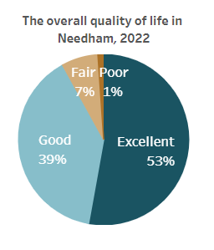
Community livability
Overall Highlights
95% rate Needham as “Excellent” or “Good” place to live
92% rate the quality of life in Needham as “Excellent” or “Good”
82% rate the quality of services provided as “Excellent” or “Good”
The majority of residents perceive the Town of Needham as a safe place to live
Inclusivity is both a strength and opportunity for continued growth in Needham.
Needham’s economy is strong but poses challenges to community affordability

Slide 5
Areas Where Needham Exceeded the National Benchmark
General Community Characteristics
Benchmark comparisons
Community characteristics
Community Characteristic | Percent Positive | Ranked | Percentile
Needham as a place to live | 95% | 22 of 403 | 94
Your neighborhood as a place to live* | 94% | 13 of 335 | 96
Needham as a place to raise children | 96% | 10 of 405 | 97
Overall image or reputation | 92% | 28 of 383 | 92
Overall quality of life | 92% | 35 of 445 | 92
Sense of community* | 84% | 24 of 337 | 93
Indicates improvement over 2018
# Indicates new question this year

Slide 6
Areas Where Needham Exceeded the National Benchmark
Community Characteristics by Facet
Benchmark comparisons
community characteristics
Safety | Percent Positive | Ranked | Percentile
Overall feeling of safety | 98% | 4 of 385 | 99
In Needham's downtown/commercial area during the day | 99% | 5 of 344 | 98
From property crime | 98% | 1 of 166 | 100
From violent crime | 99% | 2 of 166 | 99
From fire, flood or other natural disaster# | 93% | 6 of 154 | 96
* Indicates improvement over 2018
# Indicates new question this year

Slide 7
Benchmark comparisons community characteristics
Areas Where Needham Exceeded the National Benchmark
Community Characteristics by Facet
Health and Wellness | Percent Positive | Ranked | Percentile
Availability of affordable quality health care | 78% | 24 of 303 | 92
Availability of preventive health services | 82% | 25 of 286 | 91
Availability of affordable quality mental health care | 55% | 49 of 286 | 83
Economy | Percent Positive | Ranked | Percentile
Overall economic health of Needham* | 92% | 16 of 310 | 95
Needham as a place to work* | 81% | 33 of 388 | 91
* Indicates improvement over 2018
# Indicates new question this year

Slide 8
Benchmark comparisons community characteristics
Areas Where Needham Exceeded the National Benchmark
Community Characteristics by Facet
Mobility | Percent Positive | Ranked | Percentile
Traffic flow on major streets* | 69% | 62 of 358 | 82
Ease of public parking* | 77% | 48 of 283 | 83
Ease of travel by car* | 87% | 39 of 337 | 88
Ease of walking* | 85% | 28 of 339 | 92
Natural Environment | Percent Positive | Ranked | Percentile
Cleanliness* | 93% | 45 of 341 | 87
Air Quality | 93% | 32 of 294 | 89
Indicates improvement over 2018
# Indicates new question this year

Slide 9
Benchmark comparisons community characteristics
Areas Where Needham Exceeded the National Benchmark
Community Characteristics by Facet
Education and Enrichment | Percent Positive | Ranked | Percentile
Overall opportunities for education, culture, and the arts | 80% | 60 of 307 | 80
Adult educational opportunities | 86% | 6 of 292 | 98
K-12 education | 93% | 14 of 308 | 95
Indicates improvement over 2018
# Indicates new question this year

Slide 10
Benchmark comparisons
How well is Needham Government doing its job?
Areas Where Needham Exceeded the National Benchmark
General Governance
General Governance | Percent Positive | Ranked | Percentile
The job Needham government does at welcoming resident involvement | 66% | 37 of 350 | 89
Overall confidence in Needham government | 68% | 26 of 311 | 91
Generally acting in the best interest of the community | 71% | 25 of 314 | 92
Being honest* | 74% | 26 of 304 | 91
Treating all residents fairly* | 76% | 21 of 311 | 93
Treating residents with respect# | 83% | 11 of 158 | 93
Overall customer service by Needham employees* | 93% | 23 of 400 | 94
Indicates improvement over 2018
# Indicates new question this year

Slide 11
Areas Where Needham Exceeded the National Benchmark
Governance by Facet
Benchmark comparisons
How well is Needham Government doing its job?
Safety | Percent Positive | Ranked | Percentile
Police services | 93% | 43 of 436 | 90
Crime prevention | 94% | 5 of 384 | 98
Animal control | 81% | 34 of 348 | 90
Emergency preparedness | 81% | 25 of 317 | 92
Code enforcement# | 62% | 65 of 386 | 83
Mobility | Percent Positive | Ranked | Percentile
Snow removal* | 82% | 28 of 286 | 90
Indicates improvement over 2018
# Indicates new question this year

Slide 12
Areas Where Needham Exceeded the National Benchmark
Governance by Facet
Benchmark comparisons
How well is Needham Government doing its job?
Natural Environment | Percent Positive | Ranked | Percentile
Drinking water* | 86% | 34 of 329 | 89
Built Environment | Percent Positive | Ranked | Percentile
Affordable high-speed internet# | 77% | 3 of 152 | 98
Storm water management* | 87% | 22 of 353 | 94
Sewer services | 91% | 11 of 331 | 96
Indicates improvement over 2018
# Indicates new question this year

Slide 13
Areas Where Needham Exceeded the National Benchmark
Governance by Facet
Benchmark comparisons
How well is Needham Government doing its job?
Health & Wellness | Percent Positive | Ranked | Percentile
Health services | 90% | 6 of 278 | 98
Education and Enrichment | Percent Positive | Ranked | Percentile
Public library services | 96% | 21 of 353 | 94
Indicates improvement over 2018
# Indicates new question this year

Slide 14
Areas Where Needham Exceeded the National Benchmark
Community Engagement by Facet
Benchmark comparisons
How engaged Is the Needham community?
General Engagement | Percent Positive | Ranked | Percentile
Sense of civic/community pride# | 82% | 11 of 155 | 98
Neighborliness of residents* | 78% | 20 of 299 | 93
Contacted the Town for help or information* | 59% | 29 of 360 | 92
Watched a local public meeting* | 35% | 45 of 279 | 84
Indicates improvement over 2018
# Indicates new question this year

Slide 15
Areas Where Needham Exceeded the National Benchmark
Participation by Facet
Benchmark comparisons
How engaged Is the Needham community?
Mobility | Percent Positive | Ranked | Percentile
Used public transportation instead of driving | 39% | 41 of 271 | 85
Walked or biked instead of driving* | 73% | 47 of 298 | 84
Indicates improvement over 2018
# Indicates new question this year

Slide 16
Areas Where Needham Fell below the National Benchmark
Benchmark comparisons
How engaged Is the Needham community?
Facet | Percent Positive | Ranked | Percentile
Cost of living | 20% | 257 of 306 | 16
Availability of affordable quality housing | 17% | 295 of 340 | 13
Variety of housing options | 25% | 281 of 315 | 11
Garbage collection | 42% | 362 of 362 | 0

Slide 17
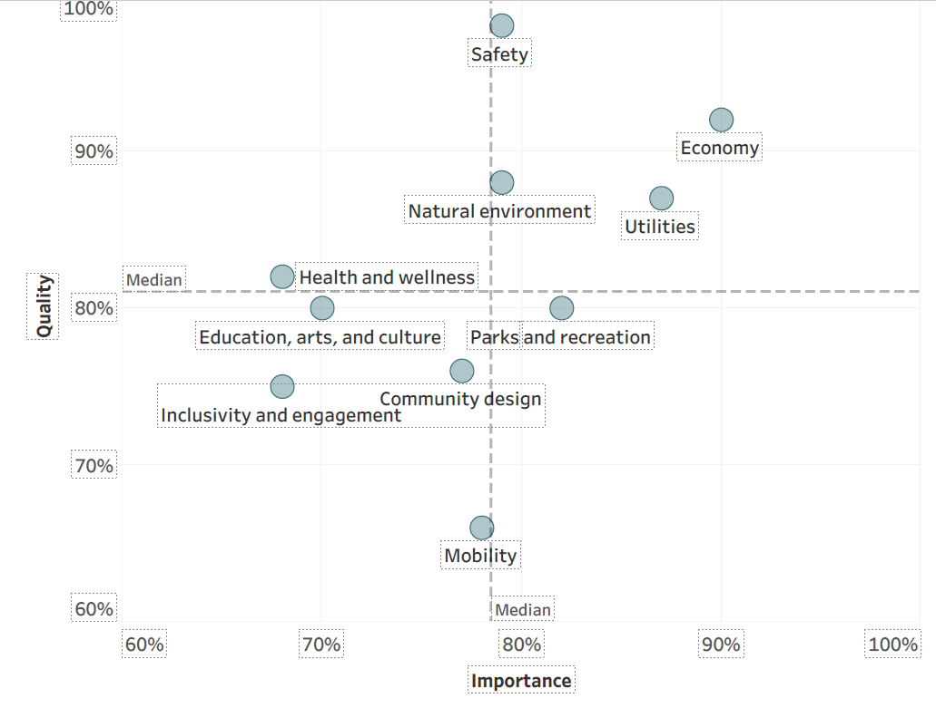
How do residents’ priorities and satisfaction with quality of services align?
Services receiving quality ratings of excellent or good by 81% or more of respondents were considered of “higher quality” and those with ratings lower than 81% were considered to be of “lower quality.” Services were classiﬁed as “more important” if they were rated as essential or very important by 78% or more of respondents. Services were rated as “less important” if they received a rating of less than 78%. This classiﬁcation uses the median ratings for quality and importance to divide the services in half.

Slide 18
Custom questions
In the last year, how often, if at all, did you worry about you, someone in your family or any other person of your same race, ethnicity or nationality experiencing unfair treatment because of your race, ethnicity, or color?

Slide 19
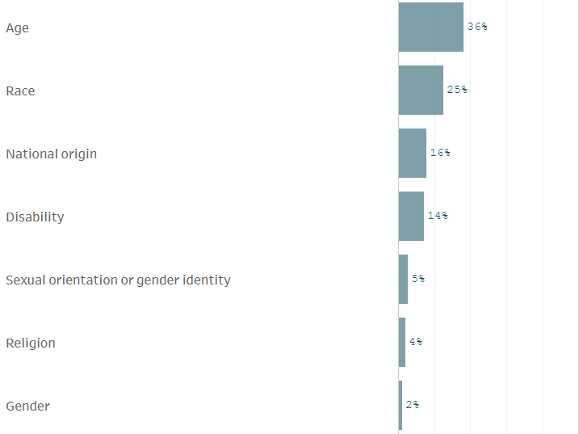
Custom questions
Please indicate whether or not you currently perceive barriers to living in Needham based on each of the following.

Slide 20
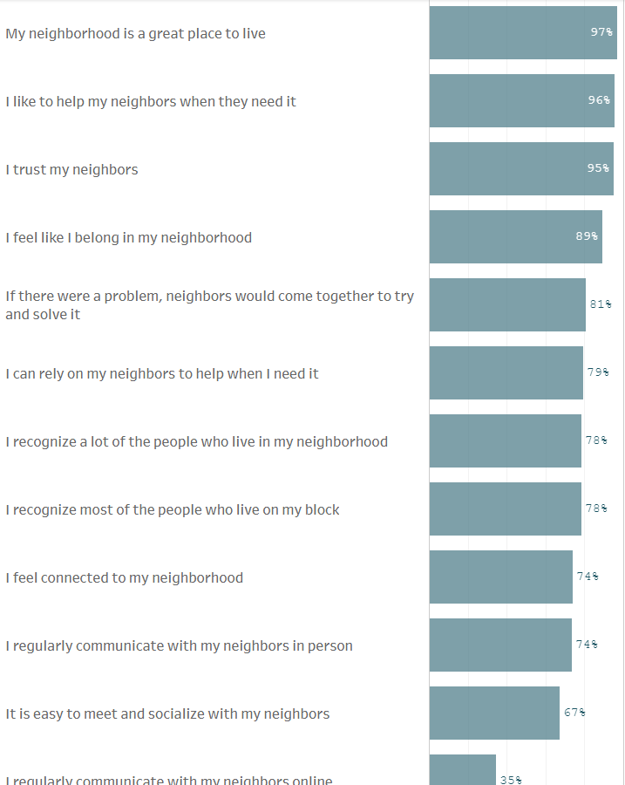
Custom questions
How strongly do you agree or disagree with the following statements about your neighborhood?

Slide 21

Custom questions
Q: How familiar are you with the Town’s efforts to make people of all races feel welcome?

Slide 22
Trends over time
Key Trends Comparison 2008 - 2022
Characteristic | 2008 Rating | 2022 Rating | % Change
Needham as a place to live | 96% | 95% | -1%
Needham as a place to work | 72% | 81% | 13%
Overall quality of life | 91% | 92% | 1%
Quality of services | 85% | 82% | -4%
Overall feeling of safety* | 97% | 98% | 1%
Overall quality of business & service establishments | 63% | 80% | 27%
Availability of quality affordable housing | 17% | 22% | 29%
Openness and acceptance of the community toward people of diverse backgrounds | 69% | 66% | -4%
Overall image or reputation | 89% | 92% | 3%
* Indicates data not collected before 2014
Margin of error = 4%

Slide 23

THANK YOU

